Slide 1
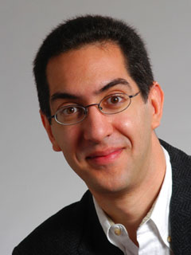
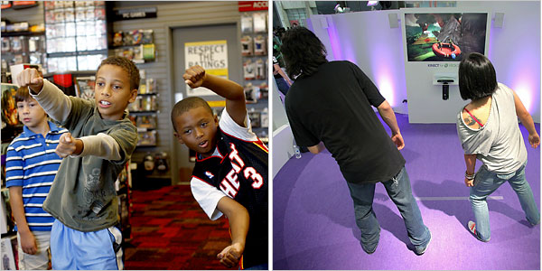
Ms kinect = body I/O
CS10 The Beauty and Joy of Computing Lecture #25 : Tree Recursion
2010-11-29
UC Berkeley EECS Lecturer SOE Dan Garcia
The newly released (and much-hyped) Microsoft Kinect system for the XBOX 360 used controller-free body motions to control games, music, and movies.
xbox.com/kinect/

Slide 2
Review: What’s in a Strong Solution
For every position
Assuming alternating play
Value … (for player whose turn it is)
Winning (∃ losing child)
Losing (All children winning)
Tieing (!∃ losing child, but ∃ tieing child)
Drawing (can’t force a win or be forced to lose)
Remoteness
How long before game ends?
W
L
...
...
W
W
W
L
W
W
W
W
T
D
D
...
...
W
W
W
T
W
W
W
W

Slide 3

Review : Example: 1,2,…,10
Rules (on your turn):
Running total = 0
Rules (on your turn):
Add 1 or 2 to running total
Goal
Be the FIRST to get to 10
Example
Ana: “2 to make it 2”
Bob: “1 to make it 3”
Ana: “2 to make it 5”
Bob: “2 to make it 7” → photo
Ana: “1 to make it 8”
Bob: “2 to make it 10” I WIN!
7 ducks (out of 10)

Slide 4
Let’s write code to determine value!
0 = Win
1 = Lose
2 = Win
3 = Win
4 = Lose
5 = Win
6 = Win
7 = Lose
8 = Win
9 = Win
10 = Lose
P = Position
M = Move
We only need 3 blocks to define a game
Do Move M on Position P
➔ a new Position
Generate Moves from Position P
➔ list of Moves
Primitive Value of Position P
➔ {win, lose, tie, undecided}
Let’s write Value of Position P

Slide 5
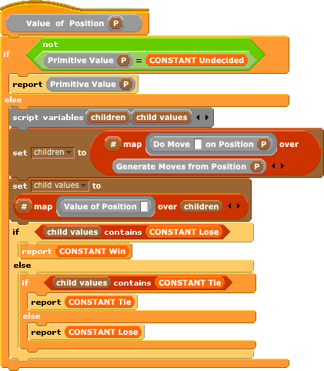
Answer

